Slide 1
VS_ Results

Slide 2
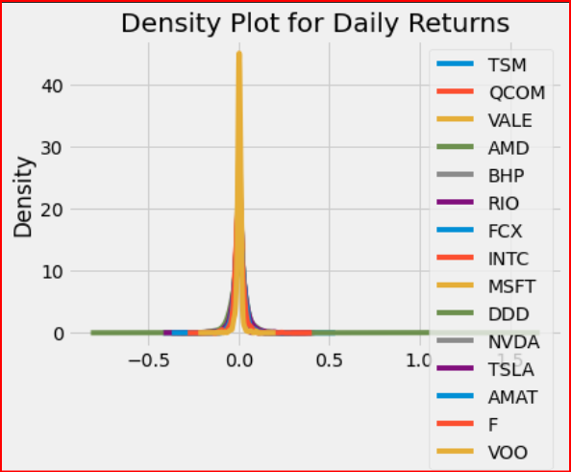
Portfolio Optimization Overview
15 Stocks Evenly Weighted
Measure | Result
Exp. Ann. Return | 49.0%
Annual Volatility | 33.0%
Annual Variance | 11.0%
Objective: Research & test a publicly available portfolio optimizer python package for a given 15 stock dataset.
Ref. Link : https://pyportfolioopt.readthedocs.io/en/latest/index.html
Standard PIP installation & import steps followed
Focus: Utilize built-in objective functions
Mean-Variance optimization
General Efficient Frontier
Cases: Maximum Sharpe; Min. Volatility & Efficient Risk with user control on maximum risk level
Data Prep Highlights:
‘Pandasdatareader’ to download stock data from yahoo
Set up returns & COV data-frames
Calculate Portfolio Variance, Volatility & annualized portfolio return to use as a base case

Slide 3
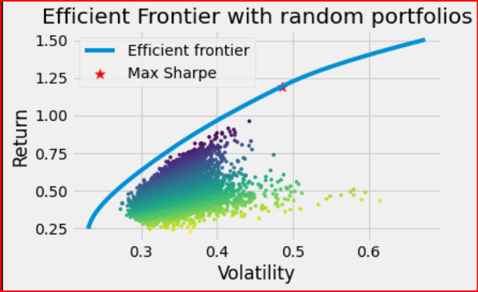
Portfolio Optimization Case: Max Sharpe
Max. Sharpe Results
Discrete Allocation
Initial Portfolio cash value set at $1.0 Million
10,000 Random Portfolios
Imports from pypfopt
EfficientFrontier
risk_models
expected_returns
Randomly assigned weights to stock dataset
Constraints: Sum of weights =1.0
Cleaned Weights: Ensured that stock purchase allotments were in whole numbers
Measure | Result
Exp. Ann. Return | 119.3%
Annual Volatility | 48.6%
Sharpe Ratio | 2.42
Stock | # Shares
TSM | 265
AMD | 774
NVDA | 1939
TSLA | 635

Slide 4
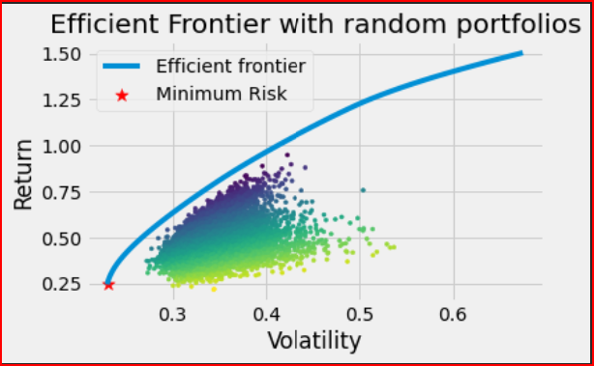
Portfolio Optimization Case: Min. Volatility
Min. Volatility Results
Same set up as first case
Constraints:
Efficient Frontier set to minimum volatility
Sum of weights =1.0
Observations:
99% of the initial investment was allocated to just one stock (VOO)
Measure | Result
Exp. Ann. Return | 24.5%
Annual Volatility | 23.0%
Sharpe Ratio | 0.98
Discrete Allocation
Stock | # Shares
TSM | 91
VOO | 2487

Slide 5
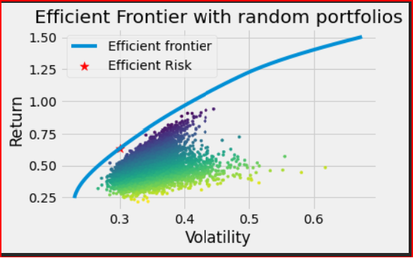
Portfolio Optimization Case: Efficient Risk
Discrete Allocation
Stock | # Shares
TSM | 1747
AMD | 246
MSFT | 732
NVDA | 208
TSLA | 245
F | 1316
VOO | 804
Efficient Risk Results
Constraints:
Sum of weights =1.0
Max. Allowable Volatility pre-set to 30%
Measure | Result
Exp. Ann. Return | 63.4%
Annual Volatility | 30.0%
Sharpe Ratio | 2.05

